Slide 1

Innovative Database and Information Systems Research Laboratory
idir.uta.edu
Chengkai Li, Associate Professor
Research areas
Big Data and Data Science (Database, Data Mining, Natural Language Processing)
Research directions
computational journalism, computational fact-checking (global leading position, well-known in both computing and professional fact-checking communities)
crowdsourcing and human computation
cybersecurity, social bots
data exploration by ranking/skyline/preference queries
graph database usability, knowledge graphs

Slide 2





Funding Sponsors
As PI
NSF IIS #1719054
New Knight Foundation Grant
Texas National Security Network Excellence Fund
NSF I-Corps Teams #1565699
Knight Prototype Fund
NSF IIS Medium #1408928
HP Labs Innovation Research Award, 2011 and 2012
NSF IIS #1018865
UTA REP, FDL
As Co-PI
NSF CCF #1117369
NSFC 61370019

Slide 3
In the Press

Slide 4
Achievements and Recognitions
Awards
ACM SIGMOD 2017 Most Reproducible Paper
First Runner-Up Award in SIGMOD17 Undergraduate Research Competition (Damian Jimenez)
VLDB 2014 Excellent Demonstration Award
2011 and 2012 HP Labs Innovation Research Award
3rd place in best Vision Track paper competition in CIDR 2011
Publications in top-tier conferences and journals
SIGMOD, VLDB, ICDE, EDBT, CIDR, KDD, WWW, CIKM, WSDM, ISWC, TODS, TKDD, TKDE
Keynotes/panels/invited talks
SXSW 2017, MetroCon 2017, PyData 2015, Data4U workshop (VLDB 14), ACS workshop (SDM 13)
Professional services
General Chair/Program Chair (IEEE IPCCC), Finance Chair (SIGMOD17), Publicity Chair (WAIM16)
Associate editor of top-tier journals
Program committee member and editorial board member of many top-tier conferences and journals

Slide 5
IDIR Students
Current students
7 Ph.D. students, 3 M.S. thesis students, 2 B.S. students (including REUs)
Graduated students
4 Ph.D. students, 18 M.S. thesis and GRA students, 9 B.S. students (including REUs)
Internships
Amazon A9 Labs, AT&T, Google, HP Labs, Huawei, IBM Research India, NEC Labs, Qatar Computing Research Institute (QCRI), RedHat
First-employment after graduation
Tenure-track assistant professor : University of Mississippi
Researchers: Huawei US R&D Center, IBM Research India
Software engineers: Akamai, Amazon, Ambit Energy, Capital One, Cerner, Copper Labs, Dematic, Electronic Arts (EA) , Google, Microsoft, Pivotal

Slide 6
Collaborators
On current projects
Bill Adair (Duke)
Pankaj Agarwal (Duke)
Xiang Ao (Chinese Academy of Sciences)
Vassilis Athitsos (UTA)
Sourav Bhowmick (Nanyang Technological University )
Byron Choi (Hong Kong Baptist University)
Christoph Csallner (UTA)
Peter Frays (University of Technology Sydney)
James Hamilton (Stanford)
Naeemul Hassan (Mississippi)
Wei Hu (Nanjing University)
Angela Lee (UTD)
Zhiqiang Lin (UTD)
Ping Luo (Chinese Academy of Sciences)
Mark Tremayne (UTA)
Jun Yang (Duke)
Cong Yu (Google)
On past projects
Sharma Chakravarthy (UTA)
Fei Chen (LinkedIn)
Shimin Chen(Chinese Academy of Sciences)
Gautam Das (UTA)
Chris Ding (UTA)
Ramez Elmasri (UTA)
Leonidas Fegaras (UTA)
Arijit Khan (Nanyang Technological University)
Min Wang (Visa Research)
Xifeng Yan (UCSB)
Nan Zhang (Penn State)

Slide 7


Toward the Holy Grail of Automated Fact-checking
idir.uta.edu/claimbuster

Slide 8
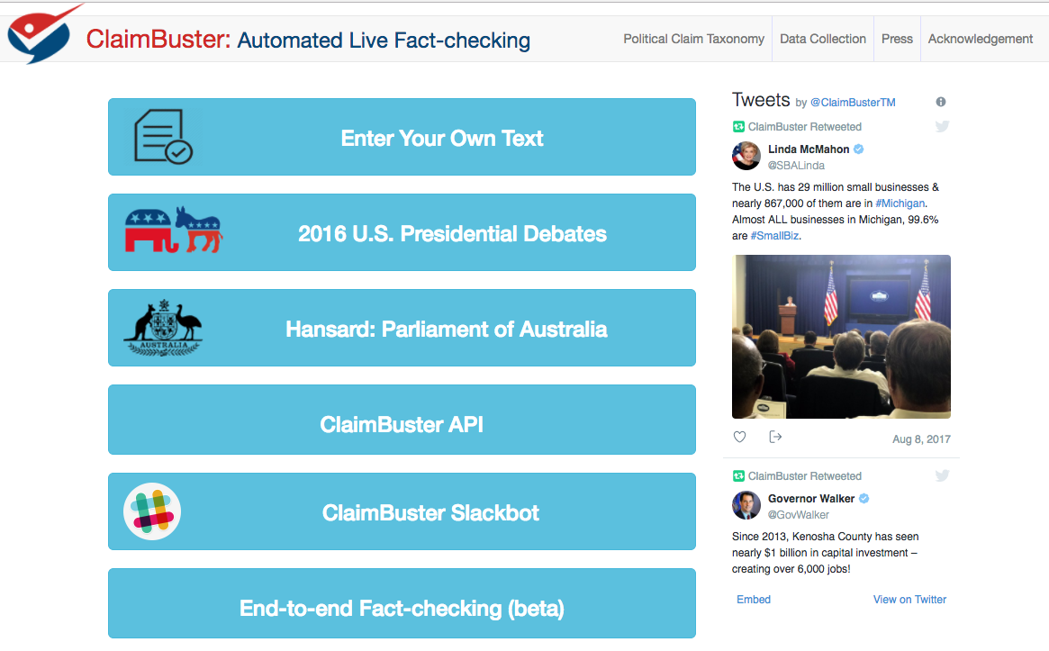

Slide 9

IDIR Projects and Demos
Demonstration Videos https://vimeo.com/channels/1024406
Botminator: Automated Detection of Fact-news Bots
ClaimBuster (idir.uta.edu/claimbuster) Automated, Live Fact-Checking
CrewScout (idir.uta.edu/crewscout) Expert Team Finding by Skyline Groups
ERQ: Entity-Relationship Query (idir.uta.edu/erq) Structured Entity-Centric Query on Wikipedia
Facetedpedia (idir.uta.edu/facetedpedia) Faceted search interface for Wikipedia
FactWatcher (idir.uta.edu/factwatcher) Automated Monitoring of Facts from Real-World Events
GQBE (idir.uta.edu/gqbe) Graph Query by Example
Orion (idir.uta.edu/orion) Auto-suggestion for Interactive Graph Query Formulation
TableView Generating Preview Tables for Knowledge Graphs
9
System idir.uta.edu/claimbuster
System idir.uta.edu/claimbuster

